Slide 1
4-02 FlexBox 1D
Joseph Suchan
Hyndavi Musipatla
Abhinay Kaitha
Mushafiq Fakki
Subash Veeramachaneni

Slide 2
Overview
What is Flexbox?
Flexbox Elements
Flexbox Layout
Flexbox Properties
Perfect Centering
Child Elements(items)
How to use Flex Container?
Child Properties
Resources.

Slide 3
What is Flexbox?
The Flexible Box Layout Module, makes it easier to design flexible responsive layout structure without using float or positioning.

Slide 4
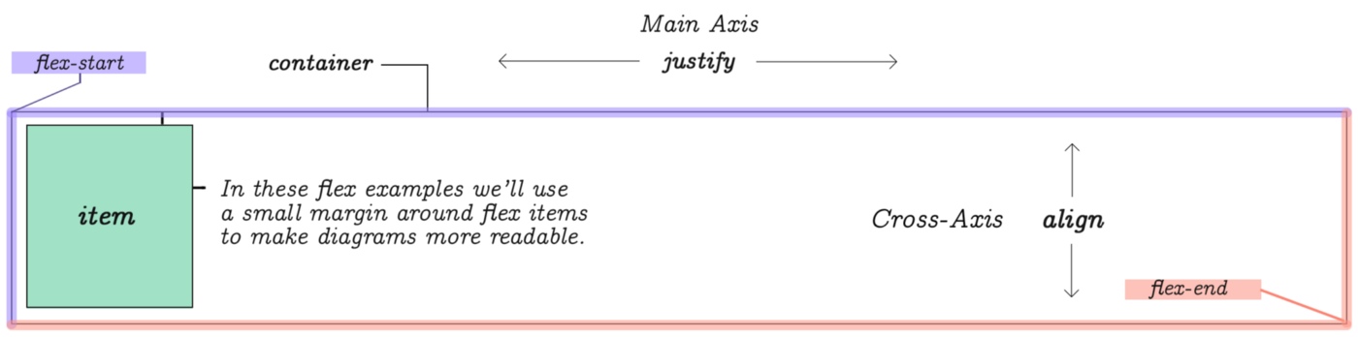
Flexbox Elements:
To start using the Flexbox model, you need to first define a flex container.
The element above represents a flex container with one flex item.

Slide 5
Flexbox Elements:
Structure :
Parent(flex container)
Children(flex item)
Two Axis:
Main axis(justify)
Cross axis(align)

Slide 6
Flexbox Layout:
.flex-container { display: flex; }

Slide 7
Flexbox Properties:
The flex container properties are:
flex-direction
flex-wrap
flex-flow
justify-content
align-items
align-content

Slide 8
Flex-direction property:
The flex-direction property defines the container wants to stack the flex items.
Row
Row-reverse
column
Column-reverse

Slide 9
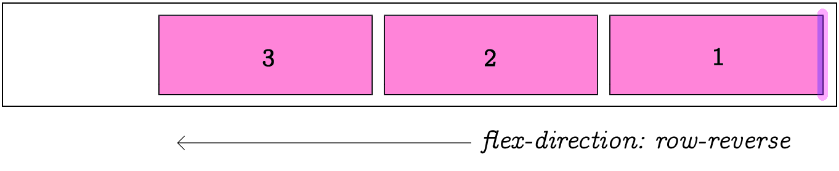
Row-Reverse Example: .flex-container { display: flex; flex-direction: row-reverse; }

Slide 10
The flex-wrap Property:
The flex-wrap property specifies whether the flex items should wrap or not.
Wrap
Nowrap
Wrap-reverse

Slide 11
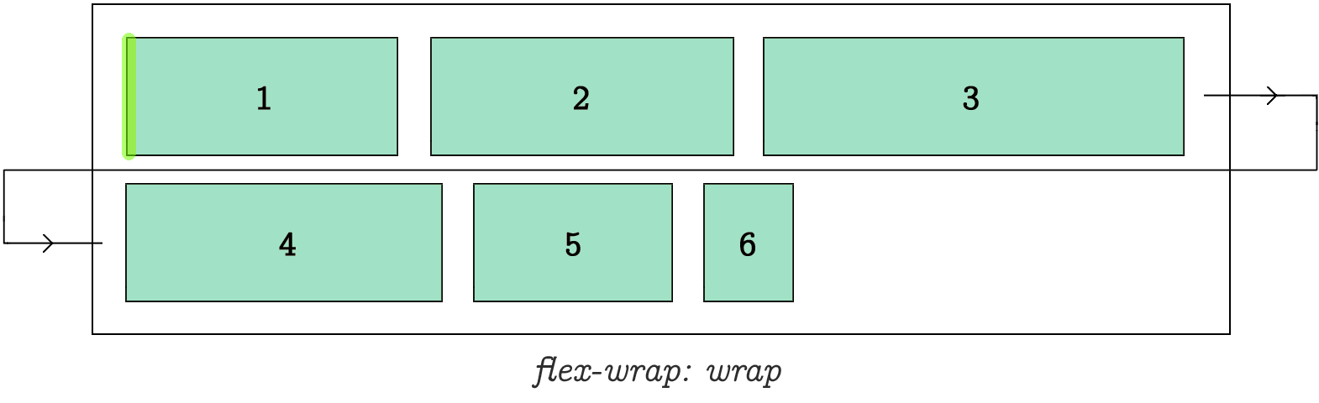
Wrap Example: .flex-container { display: flex; flex-wrap: wrap; }

Slide 12
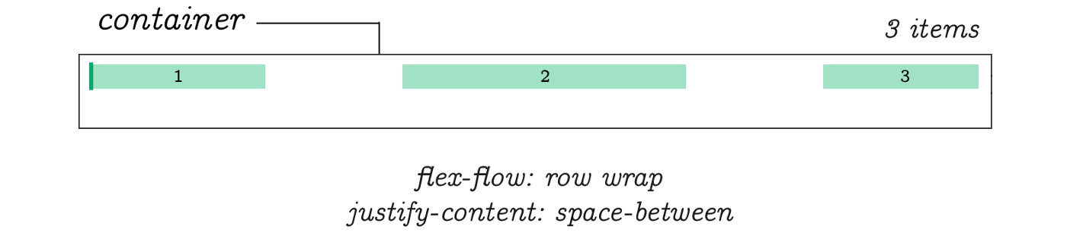
The flex-flow Property:
It is for setting both flex-direction and flex-wrap properties.
.flex-container { display: flex; flex-flow: row wrap; }

Slide 13
The justify-content Property:
It is used to align the flex items
Center
Flex-start
Flex-end
Space-around
Space-between

Slide 14
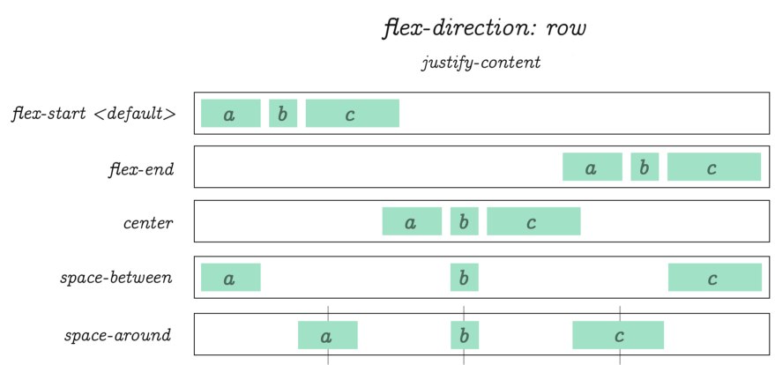
Center Example: .flex-container { display: flex; justify-content: center; }

Slide 15
The align-items Property:
It is used to align the flex items vertically.
Center
Flex-start
Flex-end
Stretch
Baseline

Slide 16
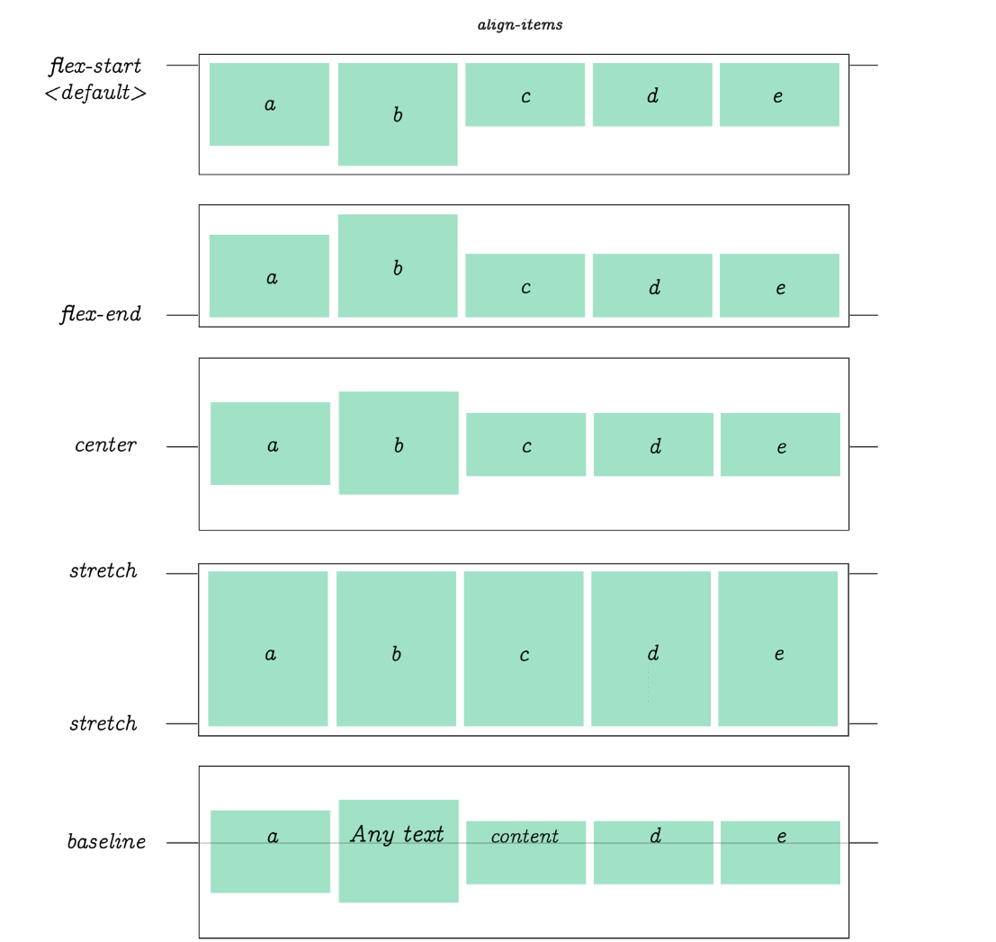
Center Example: .flex-container { display: flex; height: 200px; align-items: center; }

Slide 17
The align-content Property:
It is used to align the flex lines.
Space-between
Space-around
Center
Flex-start
Flex-End

Slide 18
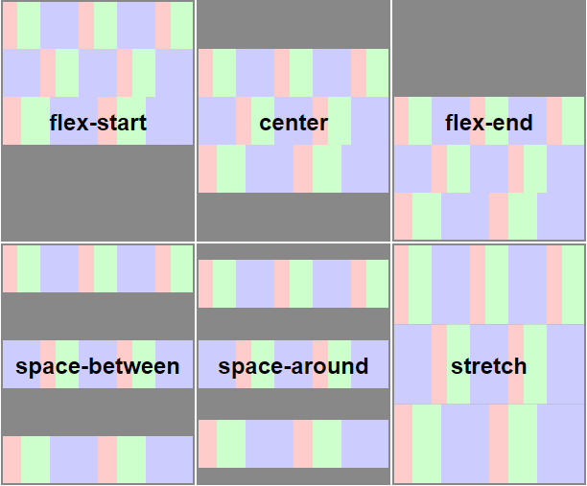
Center Example: .flex-container { display: flex; height: 600px; flex-wrap: wrap; align-content: center; }

Slide 19

Perfect Centering:
Set both the justify-content and align-items properties to center, and the flex item will be perfectly centered.
.flex-container { display: flex; height: 300px; justify-content: center; align-items: center; }

Slide 20
Child Elements (Items)
The flex item properties are:
order
flex-grow
flex-shrink
flex-basis
flex
align-self

Slide 21

How to use flex-container?
<div class="flex-container"> <div>1</div> <div>2</div> <div>3</div> <div>4</div> </div>

Slide 22

The order Property:
The order property specifies the order of the flex items.
The first flex item in the code does not have to appear as the first item in the layout.
<div class="flex-container"> <div style="order: 3">1</div> <div style="order: 2">2</div> <div style="order: 4">3</div> <div style="order: 1">4</div> </div>

Slide 23

The flex-grow Property:
The flex-grow property specifies how much a flex item will grow relative to the rest of the flex items.
<div class="flex-container"> <div style="flex-grow: 1">1</div> <div style="flex-grow: 1">2</div> <div style="flex-grow: 8">3</div> </div>

Slide 24

The flex-shrink Property
It specifies how much a flex item will shrink relative to the rest of the flex items.
<div class="flex-container"> <div>1</div> <div>2</div> <div style="flex-shrink: 0">3</div> <div>4</div> <div>5</div> <div>6</div> <div>7</div> <div>8</div> <div>9</div> <div>10</div> </div>

Slide 25

The flex-basis Property
It specifies the intial length of a flex item.
<div class="flex-container"> <div>1</div> <div>2</div> <div style="flex-basis: 200px">3</div> <div>4</div> </div>

Slide 26
The flex Property
The flex property is a short hand property for flex-grow,flex-basis and flex-shrink property
<div class="flex-container"> <div>1</div> <div>2</div> <div style="flex: 0 0 200px">3</div> <div>4</div> </div>

Slide 27
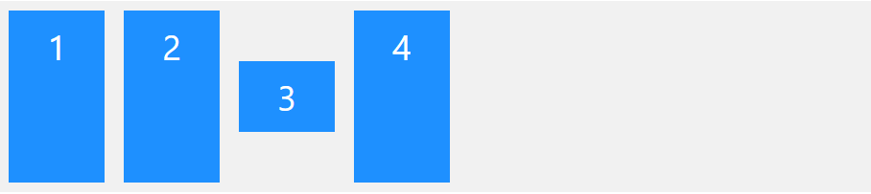
The align-self Property
It specifies the alignment for the selected item inside the flexible container
<div class="flex-container"> <div>1</div> <div>2</div> <div style="align-self: center">3</div> <div>4</div> </div>

Slide 28
Resources:
https://www.w3schools.com/bootstrap/bootstrap_navbar.asp
https://mdbootstrap.com/docs/jquery/navigation/footer/

Slide 29
THANK YOU

